Slide 1
Unstructured data
Vijayalakshmi Anand

Slide 2
Text Books
Data Mining: Concepts and Techniques, Second Edition 2005 by Jiawei Han and Micheline Kamber Morgan Kaufmann Publishers
Text Data Management and Analysis: A Practical Introduction to Information Retrieval and Text Mining ChengXiang Zhai, Sean Massung, ACM Books 2016
Web data Mining - Exploring Hyperlinks, Contents and Usage Data, By Bing Liu, Second Edition, Springer, July 2011
Source Courtesy: Some of the contents of this presentation are sourced from materials provided by publishers of prescribed books
04/08/2022
<number>

Slide 3
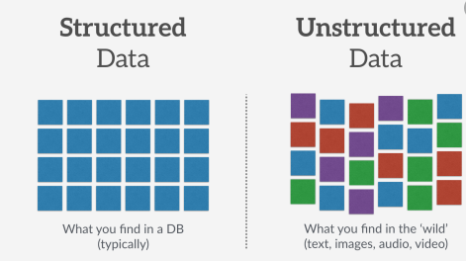
Structured data vs. Unstructured data
Structured data
comprised of clearly defined data types whose pattern makes them easily searchable
Unstructured data – “everything else”
comprised of data that is usually not as easily searchable, including formats like audio, video, and social media postings
04/08/2022
<number>

Slide 4
Unstructured Data
Can be
Text
www
Multimedia
Graph
Spatial data
……
04/08/2022
<number>

Slide 5
Mining Text Data
4/8/22
<number>

Slide 6

Mining Text Data: An Introduction
Data Mining / Knowledge Discovery
Structured Data Multimedia Free Text Hypertext
HomeLoan (
Loanee: Frank Rizzo
Lender: MWF
Agency: Lake View
Amount: $200,000
Term: 15 years
)
Frank Rizzo bought
his home from Lake
View Real Estate in
1992.
He paid $200,000
under a15-year loan
from MW Financial.
<a href>Frank Rizzo
</a> Bought
<a hef>this home</a>
from <a href>Lake
View Real Estate</a>
In <b>1992</b>.
<p>...
Loans($200K,[map],...)
04/08/2022
<number>
Notes:
<number>
Throughout this course we have been discussing Data Mining over a variety of data types.
Two former types we covered were Structured Data (relational) and multimedia data.
Today and in the last class we have been discussing Data Mining over free text,
and our next section will cover hypertext, such as web pages.
Text mining is well motivated, due to the fact that much of the world’s data can be
found in free text form (newspaper articles, emails, literature, etc.). There is a
lot of information available to mine.
While mining free text has the same goals as data mining in general
(extracting useful knowledge/stats/trends), text mining must overcome
a major difficulty – there is no explicit structure.
Machines can reason will relational data well since schemas are explicitly available.
Free text, however, encodes all semantic information within natural language. Our
text mining algorithms, then, must make some sense out of this natural language
representation. Humans are great at doing this, but this has proved to be a problem for machines.

Slide 7
Text Databases and IR
Text databases (document databases)
Data stored is usually semi-structured
Information retrieval techniques
field developed in parallel with database systems
Information retrieval problem: locating relevant documents based on user input, such as keywords or example documents
04/08/2022
<number>
Notes:
<number>

Slide 8
Information Retrieval
Typical IR systems
Online library catalogs
Online document management systems
Information retrieval vs. database systems
Some DB problems are not present in IR, e.g., update, transaction management, complex objects
Some IR problems are not addressed well in DBMS, e.g., unstructured documents, approximate search using keywords and relevance
04/08/2022
<number>
Notes:
<number>

Slide 9
Basic Measures for Text Retrieval
Relevant
Relevant & Retrieved
Retrieved
All Documents
Precision: the percentage of retrieved documents that are in fact relevant to the query (i.e., “correct” responses)
Recall: the percentage of documents that are relevant to the query and were, in fact, retrieved
04/08/2022
<number>
Notes:
<number>

Slide 10
Information Retrieval Techniques
Basic Concepts
A document can be described by a set of representative keywords called index terms.
Different index terms have varying relevance when used to describe document contents.
This effect is captured through the assignment of numerical weights to each index term of a document. (e.g.: frequency, tf-idf)
DBMS Analogy
Index Terms → Attributes
Weights → Attribute Values
04/08/2022
<number>
Notes:
<number>

Slide 11
Indexing Process
Text + Meta data
(Doc type, structure,
features, size, etc.)
Takes index terms and
creates data structures
(indexes) to support
fast searching
Identifies and stores
documents for indexing
Transforms documents into
index terms or features
or Text Processing
<number>
04/08/2022

Slide 12
Zipf’s Law
Distribution of word frequencies is very skewed
Few words occur very often, many hardly ever occur
e.g., “the” and “of”, two common words, make up about 10% of all word occurrences in text documents
Zipf’s law:
The frequency f of a word in a corpus is inversely proportional to its rank r (assuming words are ranked in order of decreasing frequency)
where k is a constant for the corpus
k
f =
r
f × r = k
<number>
04/08/2022

Slide 13
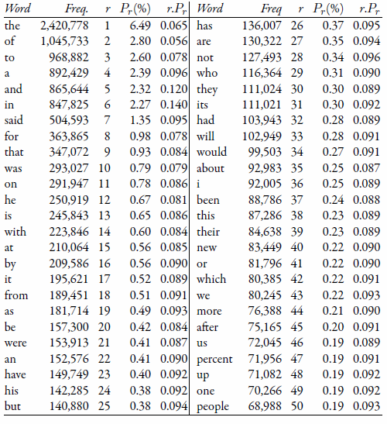
Top 50 Words from AP89
Associated Press collection of news stories from 1989 (called AP89)
<number>
04/08/2022

Slide 14
Vocabulary Growth
Heaps’ Law, another prediction of word occurrence
As corpus grows, so does vocabulary size. However, fewer new words when corpus is already large
Observed relationship (Heaps’ Law):
v = k × n^{β}
where
Predicting that the number of new words increases very rapidly when the corpus is small
v is the vocabulary size (number of unique words)
n is the total number of words in corpus
k, β are parameters that vary for each corpus
(typical values given are 10 ≤ k ≤ 100 and β ≈ 0.5)
<number>
04/08/2022

Slide 15
Heaps’ Law Predictions
Number of new words increases very rapidly when the corpus is small, and continue to increase indefinitely
Predictions for TREC collections are accurate for large numbers of words, e.g.,
First 10,879,522 words of the AP89 collection scanned
Prediction is 100,151 unique words
Actual number is 100,024
Predictions for small numbers of words (i.e., < 1000) are much worse
<number>
04/08/2022

Slide 16
Heaps’ Law on the Web
Heaps’ Law works with very large corpora
New words occurring even after seeing 30 million!
Parameter values different than typical TREC values
New words come from a variety of sources
Spelling errors, invented words (e.g., product, company names), code, other languages, email addresses, etc.
Search engines must deal with these large and growing vocabularies
Text REtrieval Conference - TREC
<number>
04/08/2022

Slide 17
Information Retrieval Techniques
Index Terms (Attribute) Selection:
Stop list
Word stem
Index terms weighting methods
Terms  Documents Frequency Matrices
Information Retrieval Models:
Boolean Model (simplistic)
Vector Space Model (Document Ranking considered)
Etc.
04/08/2022
<number>
Notes:
<number>

Slide 18
Boolean Model
Consider that index terms are either present or absent in a document
As a result, the index term weights are assumed to be all binaries
A query is composed of index terms linked by three connectives: not, and, and or
e.g.: car and repair, plane or airplane
The Boolean model predicts that each document is either relevant or non-relevant based on the match of a document to the query
04/08/2022
<number>
Notes:
<number>

Slide 19
Keyword-Based Retrieval
A document is represented by a string, which can be identified by a set of keywords
Queries may use expressions of keywords
E.g., car and repair shop, tea or coffee, DBMS but not Oracle
Queries and retrieval should consider synonyms, e.g., repair and maintenance
Major difficulties of the model
Synonymy:
Polysemy:
04/08/2022
<number>
Notes:
<number>

Slide 20
Similarity-Based Retrieval in Text Data
Finds similar documents based on a set of common keywords
Answer should be based on the degree of relevance based on the nearness of the keywords, relative frequency of the keywords, etc.
Basic techniques
Stop list
Set of words that are deemed “irrelevant”, even though they may appear frequently
E.g., a, the, of, for, to, with, etc.
Stop lists may vary when document set varies
04/08/2022
<number>
Notes:
<number>

Slide 21
Similarity-Based Retrieval in Text Data
Word stem
Several words are small syntactic variants of each other since they share a common word stem
E.g., drug, drugs, drugged
A term frequency table
Each entry frequent_table(i, j) = # of occurrences of the word t_{i} in document d_{i}
Usually, the ratio instead of the absolute number of occurrences is used
Similarity metrics: measure the closeness of a document to a query (a set of keywords)
Relative term occurrences
Cosine distance:
04/08/2022
<number>
Notes:
<number>

Slide 22
Vector Space Model
Represent a doc by a term vector
Term: basic concept, e.g., word or phrase
Each term defines one dimension
N terms define a N-dimensional space
Element of vector corresponds to term weight
E.g., d = (x₁,…,x_{N}), x_{i} is “importance” of term i
New document is assigned to the most likely category based on vector similarity.
04/08/2022
<number>
Notes:
<number>

Slide 23
What VS Model Does Not Specify
How to select terms to capture “basic concepts”
Word stopping
e.g. “a”, “the”, “always”, “along”
Word stemming
e.g. “computer”, “computing”, “computerize” => “compute”
Latent semantic indexing
How to assign weights
Not all words are equally important: Some are more indicative than others
e.g. “algebra” vs. “science”
How to measure the similarity
04/08/2022
<number>
Notes:
<number>

Slide 24
How to Assign Weights
Two-fold heuristics based on frequency
TF (Term frequency)
More frequent within a document → more relevant to semantics
IDF (Inverse document frequency)
Less frequent among documents → more discriminative
04/08/2022
<number>
Notes:
<number>

Slide 25

TF Weighting
Weighting:
More frequent => more relevant to topic
TF= f(t,d): how many times term t appears in doc d
04/08/2022
<number>
Notes:
<number>

Slide 26

IDF Weighting
Ideas:
Less frequent among documents → more discriminative
Formula:
04/08/2022
<number>
Notes:
<number>

Slide 27

TF-IDF Weighting
TF-IDF weighting : weight(t, d) = TF(t, d) * IDF(t)
Freqent within doc → high tf → high weight
Selective among docs → high idf → high weight
04/08/2022
<number>
Notes:
<number>

Slide 28



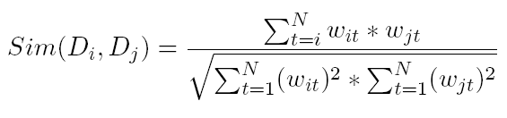
How to Measure Similarity?
Given two document
Similarity definition
dot product
normalized dot product (or cosine)
04/08/2022
<number>
Notes:
<number>

Slide 29
Illustrative Example
text
mining
search
engine
text
doc1
Sim(newdoc,doc1)=4.8*2.4+4.5*4.5
Sim(newdoc,doc2)=2.4*2.4
Sim(newdoc,doc3)=0
To whom is newdoc more similar?
travel
text
map
travel
doc2
text mining travel map search engine govern president congress
IDF(faked) 2.4 4.5 2.8 3.3 2.1 5.4 2.2 3.2 4.3
doc1 2(4.8) 1(4.5) 1(2.1) 1(5.4)
doc2 1(2.4 ) 2 (5.6) 1(3.3)
doc3 1 (2.2) 1(3.2) 1(4.3)
newdoc 1(2.4) 1(4.5)
government
president
congress
doc3
……
04/08/2022
<number>
Notes:
<number>

Slide 30
Probabilistic Retrieval Models
The ranking function based on the probability that a given document d is relevant to a query q,
or p(R = 1| d, q) where R ∈ {0, 1} is a binary random variable denoting relevance.
Intuitively, if a user likes document d, how likely would the user enter query q in order to retrieve document d?
04/08/2022
<number>

Slide 31
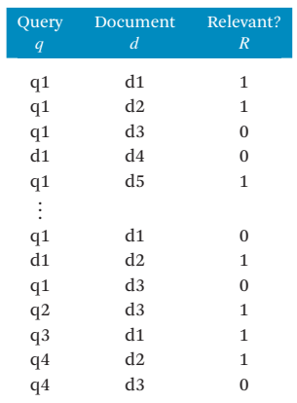
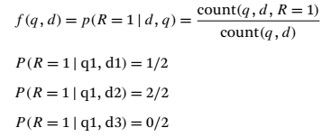

Probabilistic Retrieval Models
Clearly, p(R = 1 | d, q) + p(R = 0 | d, q) = 1
04/08/2022
<number>

Slide 32
What is Natural Language Processing?
Natural Language Processing
Process information contained in natural language text.
Also known as Computational Linguistics (CL), Human Language Technology (HLT), Natural Language Engineering (NLE)
<number>
Notes:
<number>

Slide 33

Natural Language processing
Increase of online data
Process unstructured data and extract meaningful information
Challenges
Solution-Natural langue processing

Slide 34


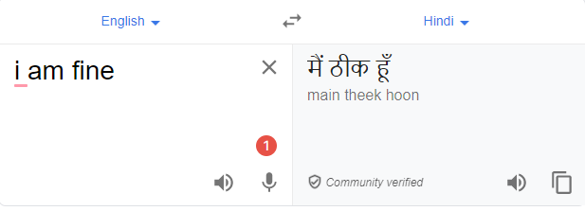

Application of NLP

Slide 35
Why NLP hard?
Ambiguity
Eg:
Teacher strikes idle kids.
Sarah gave a bath to her dog wearing a pink t-shirt.
RBI raises interest rates.

Slide 36
Ambiguities at all level
Structural Ambiguities
Namrata thinks she understands me.
She thinks Namrata understands me.
Visiting relatives can be nuisance. (two meanings)
Grammatical Ambiguities
I (feminine or masculine) go.
Can- Noun = container, Can – Modal(auxiliary verb),
Can-verb = to can means to pack etc
Lexical Ambiguities:
Polysemy Ex: "understand" (I get it)
Homonymy Ex: Bank= river, financial bank
<number>
Notes:
<number>
The challenges we face stem from the highly ambiguous nature of natural language. As an English speaker you effortlessly understand a sentence like "Flying planes can be dangerous". Yet this sentence presents difficulties to a software program that lacks both your knowledge of the world and your experience with linguistic structures. Is the more plausible interpretation that the pilot is at risk, or that the danger is to people on the ground? Should "can" be analyzed as a verb or as a noun? Which of the many possible meanings of "plane" is relevant? Depending on context, "plane" could refer to, among other things, an airplane, a geometric object, or a woodworking tool. How much and what sort of context needs to be brought to bear on these questions in order to adequately disambiguate the sentence?
Polysemy: Verbs with three levels of meanings
1) Literary, 2) Abstract, 3) Frozen
Ex: The man drank the apple juice (Literary)
The car drank gasoline (Abstract)
The idea drank the heart (Frozen)
Homonymy : Category same still different meaning

Slide 37
Some of the tasks involved in NLP
Tokeniztion
splits longer strings of text into smaller pieces, or tokens.
Eg:JavaTpoint offers Corporate Training, Summer Training, Online Training, and Winter Training.
"JavaTpoint", "offers", "Corporate", "Training", "Summer", "Training", "Online", "Training", "and", "Winter", "Training", "."
Lemmatization
capture canonical forms based on a word's lemma.
Eg:better → good

Slide 38
Contd..
Stemming
process of eliminating affixes (suffixed, prefixes, infixes, circumfixes) from a word in order to obtain a word stem.
eg. running → run
Stop Words
contribute little to overall meaning
Eg:He is a good boy.

Slide 39
N-gram language models
An N-gram model is one type of a Language Model (LM), which is about finding the probability distribution over word sequences
E.g:
There was heavy rain
There was heavy flood.

Slide 40
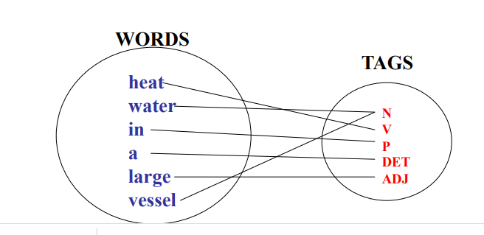
POS tagging
The process of assigning a part-of-speech to each word in a sentence

Slide 41
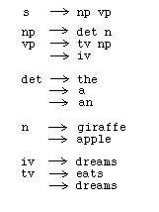
Grammars and parsing
list of rules that define the set of all well-formed sentences in a language

Slide 42
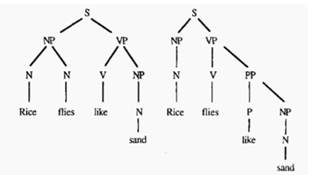
Parsing
Find that how all the words in the sentence are related to each other

Slide 43
Word sense disambiguation
the task of determining which sense of a word is being used in a particular context.
Eg:
“The bank will not be accepting cash on Saturdays. ”
“The river overflowed the bank

Slide 44
Prescribed Text Books
 | Author(s), Title, Edition, Publishing House
T1 | Tan P. N., Steinbach M & Kumar V. “Introduction to Data Mining” Pearson Education
T2 | Data Mining: Concepts and Techniques, Third Edition by Jiawei Han, Micheline Kamber and Jian Pei Morgan Kaufmann Publishers
R1 | Predictive Analytics and Data Mining: Concepts and Practice with RapidMiner by Vijay Kotu and Bala Deshpande Morgan Kaufmann Publishers
4/8/22
<number>

